Slide 1

Project Title:- The CarMarket
Pre-Own Car System
Presented by
Gaurav Patil.
Sujay Zope.
Pavan Kolhe.
Rohit Patil.

Slide 2
Introduction
Car Trading means buy/sell used cars including budget, model, prices, company etc. Our project is meant to give people a better and trustworthy platform where they can sell and buy cars of their own choice and obviously on their own terms and condition.
With the help of internet and computer systems a man from remote area can buy/sell his car from anywhere the country. This will eliminate the barrier of distance and area.
The purpose of this project is to create a Car Sales System that allows the consumer to enter Car Information.
Car Sales Management system is web-based tool to reduce communication gap between the buyer and the seller.

Slide 3
Objectives
The main purpose of “Car sales management System” is sell or buy used or second-hand
cars online.
To provide easy way for buying and selling used cars online.
To reduce manual process of buying and selling of cars.
To give the best offers to our customer.

Slide 4
Technologies Used
For Front End :
ReactJs , Html , Css , JavaScript
For Back End :
Java (Spring boot)
Database :
MySQL

Slide 5
Modules Of The Project
Admin
Seller
Buyer

Slide 6
Table Uses In Project

Slide 7
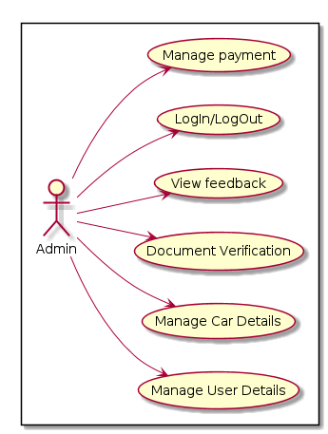
Functional Requirement
Use Case of Administrator

Slide 8
Use Case Seller

Slide 9
Use Case Of Buyer

Slide 10
Conclusion
Car sales Management system is web-based tool to reduce communication gap between the buyer and the seller. The main objective of this solution is to make buying and selling of cars easy and fast.

Slide 11
anY QUE !

Slide 12
Thank you

